Slide 1

Hotel dataset
Here is where your presentation begins

Slide 2
Overview
Dataset ini berisi informasi pemesanan hotel kota(City Hotel) dan hotel resor (Resort Hotel) dan mencakup informasi seperti kapan pemesanan dilakukan, lama menginap,banyakorang dewasa, anak-anak, dan / atau bayi, dan jumlah tempat parkir yang tersedia, dan lain-lain.

Slide 3
Data Properties
Dataset memiliki 32 kolom:
No | Nama | Banyak entry | Tipe | Jenis data
1 | hotel | 119390 | object | Categorical
2 | is_canceled | 119390 | int64 | Categorical
3 | lead_time | 119390 | int64 | Numerical
4 | arrival_date_year | 119390 | int64 | Numerical
5 | arrival_date_month | 119390 | object | Numerical
6 | arrival_date_week_number | 119390 | int64 | Numerical
7 | arrival_date_day_of_month | 119390 | int64 | Numerical
8 | stays_in_weekend_nights | 119390 | int64 | Numerical

Slide 4
Data Properties
Dataset memiliki 32 kolom:
No | Nama | Banyak entry | Tipe | Jenis data
9 | stays_in_week_nights | 119390 | int64 | Numerical
10 | adults | 119390 | int64 | Numerical
11 | children | 119386 | float64 | Numerical
12 | babies | 119390 | int64 | Numerical
13 | meal | 119390 | object | Categorical
14 | country | 118902 | object | Categorical
15 | market_segment | 119390 | object | Categorical
16 | distribution_channel | 119390 | object | Categorical

Slide 5
Data Properties
Dataset memiliki 32 kolom:
No | Nama | Banyak entry | Tipe | Jenis data
17 | is_repeated_guest | 119390 | int64 | categorical
18 | previous_cancellations | 119390 | int64 | Numerical
19 | previous_bookings_not_canceled | 119390 | int64 | Numerical
20 | reserved_room_type | 119390 | object | Categorical
21 | assigned_room_type | 119390 | object | Categorical
22 | booking_changes | 119390 | int64 | Numerical
23 | deposit_type | 119390 | object | Categorical
24 | agent | 103050 | float64 | Categorical

Slide 6
Data Properties
Dataset memiliki 32 kolom:
No | Nama | Banyak entry | Tipe | Jenis data
25 | company | 6797 | float64 | Categorical
26 | days_in_waiting_list | 119390 | int64 | Numerical
27 | customer_type | 119390 | object | Categorical
28 | adr | 119390 | float64 | Numerical
29 | required_car_parking_spaces | 119390 | int64 | Numerical
30 | total_of_special_requests | 119390 | int64 | Numerical
31 | reservation_status | 119390 | object | Categorical
32 | reservation_status_date | 119390 | object | Categorical

Slide 7
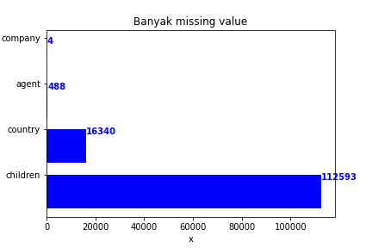
Missing values

Slide 8
Number, Mean, Median, Std
No | Nama | Banyak entry | Jenis data | Mean | median | Std
1 | hotel | 119390 | Categorical | - | - | -
2 | is_canceled | 119390 | Categorical | - | - | -
3 | lead_time | 119390 | Numerical | 104.011416 | 69.000000 | 106.863097
4 | arrival_date_year | 119390 | Categorical | - | - | -
5 | arrival_date_month | 119390 | Categorical
6 | arrival_date_week_number | 119390 | Categorical | - | - | -
7 | arrival_date_day_of_month | 119390 | Categorical | - | - | -
8 | stays_in_weekend_nights | 119390 | Numerical | 0.927599 | 1.000000 | 0.998613

Slide 9
Number, Mean, Median, Std
No | Nama | Banyak entry | Jenis data | Mean | Median | Std
9 | stays_in_week_nights | 119390 | Numerical | 2.500302 | 2.000000 | 1.908286
10 | adults | 119390 | Numerical | 1.856403 | 2.000000 | 0.579261
11 | children | 119386 | Numerical | 0.103890 | 0.000000 | 0.398561
12 | babies | 119390 | Numerical | 0.007949 | 0.000000 | 0.097436
13 | meal | 119390 | Categorical | - | - | -
14 | country | 118902 | Categorical | - | - | -
15 | market_segment | 119390 | Categorical | - | - | -
16 | distribution_channel | 119390 | Categorical | - | - | -

Slide 10
Number, Mean, Median, Std
No | Nama | Banyak entry | Tipe | Jenis data | Mean | Median | Std
17 | is_repeated_guest | 119390 | int64 | categorical | - | - | -
18 | previous_cancellations | 119390 | int64 | Numerical | 0.087118 | 0.000000 | 0.844336
19 | previous_bookings_not_canceled | 119390 | int64 | Numerical | 0.137097 | 0.000000 | 1.497437
20 | reserved_room_type | 119390 | object | Categorical | - | - | -
21 | assigned_room_type | 119390 | object | Categorical | - | - | -
22 | booking_changes | 119390 | int64 | Numerical | 0.221124 | 0.000000 | 0.652306
23 | deposit_type | 119390 | object | Categorical | - | - | -
24 | agent | 103050 | float64 | Categorical | - | - | -

Slide 11
Number, Mean, Median, Std
No | Nama | Banyak entry | Jenis data | Mean | Median | Std
25 | company | 6797 | Categorical | - | - | -
26 | days_in_waiting_list | 119390 | Numerical | 2.321149 | 0.000000 | 17.594721
27 | customer_type | 119390 | Categorical | - | - | -
28 | adr | 119390 | Numerical | 101.831122- | 94.575000- | 50.535790-
29 | required_car_parking_spaces | 119390 | Numerical | 0.062518 | 0.000000 | 0.245291-
30 | total_of_special_requests | 119390 | Numerical | -0.571363 | 0.000000 | 0.792798
31 | reservation_status | 119390 | Categorical | - | - | -
32 | reservation_status_date | 119390 | Categorical |  | - | -

Slide 12
Min dan Max
No | Nama | Jenis data | Max | Min
3 | lead_time | Numerical | 737. | 0
8 | stays_in_weekend_nights | Numerical | 19 | 0
9 | stays_in_week_nights | Numerical | 50 | 0
10 | adults | Numerical | 55 | 0
11 | children | Numerical | 10 | 0
12 | babies | Numerical | 10 | 0
18 | previous_cancellations | Numerical | 26 | 0
19 | previous_bookings_not_canceled | Numerical | 72 | 0

Slide 13
Min dan Max
No | Nama | Jenis data | Max | Min
22 | booking_changes | Numerical | 21 | 0
26 | days_in_waiting_list | Numerical | 391 | 0
28 | adr | Numerical | 5400.000 | -6.380000
29 | required_car_parking_spaces | Numerical | 8 | 0
30 | total_of_special_requests | Numerical | 5 | 0

Slide 14

1
Preprocessing

Slide 15
Missing value
Sebelum preprocessing, pertama salin dataset agar dataset asli tidak berubah
Dengan perintah dataset = df.copy()

Slide 16
Persentasi Missing value
Kolom dengan missing value > 50% adalah ‘company’
1
Kolom | Persentase hilang
company | 0.943069
agent | 0.136862
country | 0.004087
children | 0.000034
drop kolom ‘company dengan ’
dataset.drop(columns=['company'], inplace=True)

Slide 17
Mengisi missing value di ‘agent’ dengan mean
Dilakukan dengan perintah
dataset['agent'] = dataset['agent'].fillna((dataset['agent'].mean()))

Slide 18


Hasil
Sebelum | Sesudah

Slide 19
Mengisi missing value di ‘children’ dan ‘country’ dengan modus
Dengan perintah
dataset['children'] = dataset['children'].fillna(dataset['children'].mode()[0])
Dan
dataset['country'] = dataset['country'].fillna(dataset['country'].mode()[0])

Slide 20
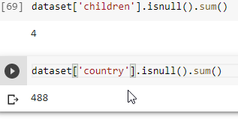
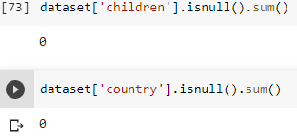
Hasil
Sebelum | Sesudah

Slide 21
Membuat Kategori Berdasar ‘lead_time’

Slide 22
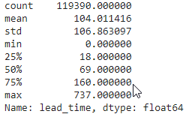
Parameter
Dengan perintah dataset[‘lead_time’].describe(), didapat
Short : <25%
Medium: 25%-75%
Long : >75%

Slide 23
Mengkategorikan ‘lead_time’
Dengan perintah:
conditions = [
dataset[‘lead_time’] <18,
(dataset[‘lead_time’]>=18)&(data[‘lead_time’]<=160),
dataset[‘lead_time’]>160
]
labels=['Short', 'Medium', 'Long']
dataset[‘Category'] = np.select(conditions, labels)

Slide 24
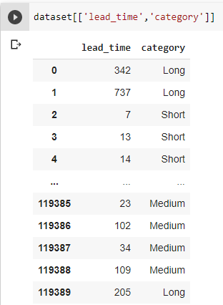
Hasil

Slide 25
Filter data 'reservation_status_date' > 2017

Slide 26
Mengkonversi ke tipe data datetime
Dengan perintah
dataset['reservation_status_date'] =
pd.to_datetime(dataset['reservation_status_date'], format='%Y-%m-%d')

Slide 27
Filter data
Dengan perintah
above_2017 = df.loc[(dataset['reservation_status_date'] >= '2017-01-01')]

Slide 28
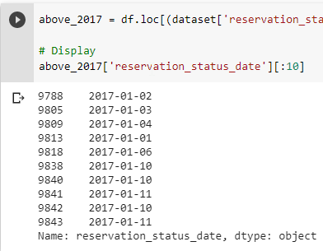
Hasil

Slide 29

05
Visualizing Arrival Month

Slide 30
Dengan perintah
import seaborn as sns
month_order = ['January', 'February', 'March', 'April', 'May', 'June', 'July', 'August’ , 'September’, 'October', 'November', 'December']
sorted_months = dataset['arrival_date_month'].value_counts().reindex(month_order)
x = sorted_months.index
y = sorted_months.values
sns.set(rc={'figure.figsize':(18,6)})
sns.lineplot(x, y)

Slide 31
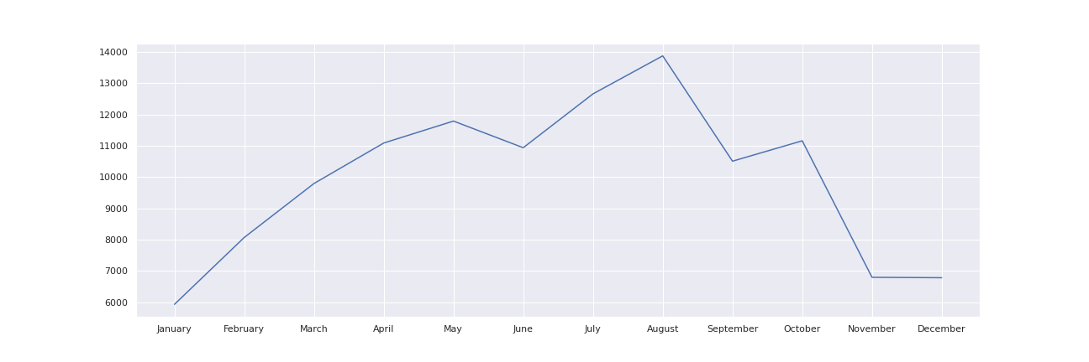
Hasil
Terlihat bahwa bulan tersibuk adalah Agustus.

